Slide 1

Did you know ?
Youtube, which has 2 billion monthly active users and is the second most-visited website on the internet, currently exists solely within Google’s internal data centre infrastructure.
Notes:
Google Cloud platform can handle the workload of YouTube. https://www.digitaltveurope.com/2021/06/07/google-shifts-parts-of-youtube-to-google-cloud-platform/#close-modal
google.com = 131,200,000,000
youtube.com = 71,400,000,000
According to a research conducted as of September 2024, by https://explodingtopics.com/blog/most-visited-websites.

Slide 2





Develop Serverless Apps with .
Google Cloud Skills for Africa
2024
Notes:
I am Cloud Engineer and a community advocate. I do enjoy inspiring others through what I learn in tech with todays focus on the Google Cloud Platform.

Slide 3

Empowering developers with Firebase for serverless app architecture
Google Cloud Skills for Africa
2024
Notes:
This talk covers the core concepts of serverless architecture, focusing on Firebase, a backend-as-a-service (BaaS) by Google. Firebase offers a collection of services that allows you to build serverless applications quickly, without managing infrastructure. Today, we will explore tools such as Firestore, Firebase Functions, and Firebase Hosting.

Slide 4
What is serverless architecture ?
A cloud computing execution model where the cloud provider dynamically manages the infrastructure for developers.
Why serverless? Key advantages: cost efficiency, scalability, and reduced operational overhead
Examples of serverless services
Google Cloud Functions
Firebase Functions
Notes:
You only pay for what you use, reducing costs significantly compared to traditional server-based architectures. Serverless platforms handle provisioning, scaling, and managing servers, which allows developers to focus solely on writing code.
Additional Details: Serverless architecture is ideal for unpredictable workloads, where auto-scaling is crucial. Services like AWS Lambda, Google Cloud Functions, and Firebase Functions exemplify this paradigm, allowing functions to run in response to events without server management.
Example: A use case for serverless architecture could be a social media application that needs to scale rapidly when user traffic surges, such as during a viral event or a product launch.

Slide 5
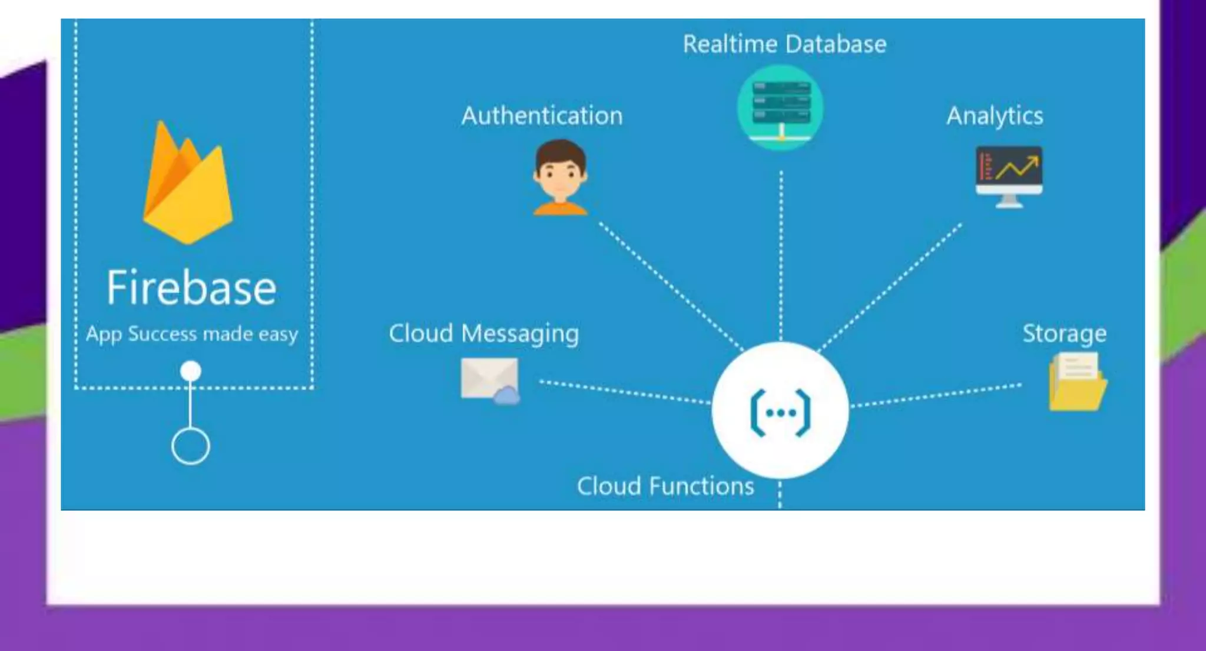
Overview of Firebase
Notes:
Firebase offers a unified platform for building both mobile and web applications, with features like authentication, analytics, cloud messaging, and databases. Initially focused on mobile apps, Firebase has expanded into a comprehensive serverless platform with strong support for real-time data, event-driven functions, and easy integrations with Google Cloud.
Additional Details: Firebase supports integration with Google Cloud’s serverless tools, making it easy to scale from MVPs to enterprise-level applications. The platform reduces boilerplate code, speeding up development.
Example: For example, Firebase is used by apps like Duolingo and Alibaba for handling complex, high-volume workloads with minimal infrastructure maintenance.

Slide 6

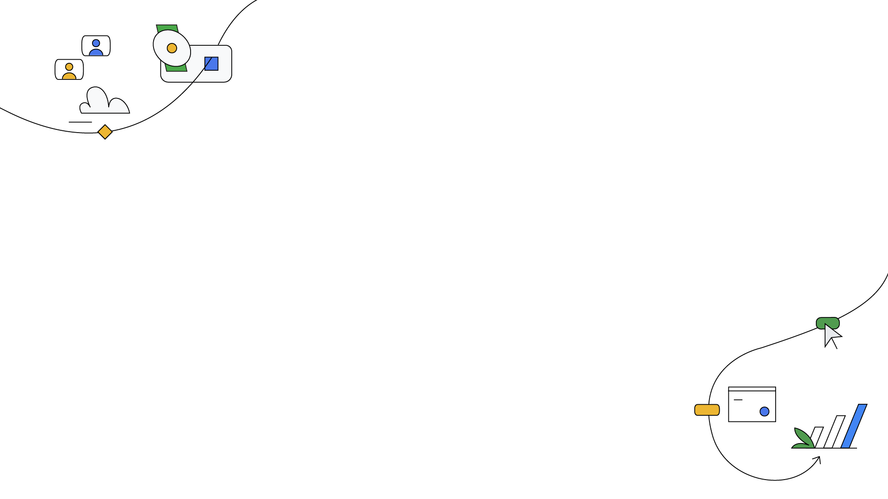
Core Firebase Tools for Serverless Development
Firestore: NoSQL database
Firebase Functions: Event-driven, serverless logic
Firebase Hosting: Static site hosting with SSL
Cloud Build: Automating deployment pipelines
Notes:
Firebase’s serverless offerings revolve around Firestore (a scalable NoSQL database), Firebase Functions (to execute backend logic), and Firebase Hosting (for deploying static and dynamic web apps). Together, these tools offer a robust environment for full-stack serverless applications.
Additional Details: Firebase’s serverless tools are tightly integrated, ensuring smooth data flow between services. Firestore synchronizes in real-time, Firebase Functions can react to database changes, and Firebase Hosting serves secure, scalable web apps. This seamless connection is ideal for developing modern web applications.
Example: A modern e-commerce platform could use Firebase Authentication for user management, Firestore to store product catalogs, and Firebase Functions for inventory updates when purchases are made.

Slide 7
Firestore for Database Management
Firestore architecture (collections and documents)
Benefits: scalability, real-time synchronization
Use cases: handling structured/unstructured data in serverless apps
Notes:
Firestore is a flexible, scalable NoSQL cloud database. It uses collections and documents to store data, offering real-time synchronization between clients and the database. Firestore allows you to structure data in a way that mirrors the relationships in your application without needing predefined schemas.
Additional Details: One of Firestore’s key features is its real-time sync across platforms (web, iOS, Android), making it a powerful tool for apps that require real-time collaboration or dynamic data. It also supports offline mode, meaning apps can continue to function even without internet connectivity.
Example: Collaborative apps like Google Docs, where multiple users are editing data simultaneously, are prime candidates for Firestore due to its low-latency synchronization.

Slide 8


Slide 9

Authentication is the digital key that unlocks the gateway to trust, securing our virtual realms and ensuring that only those with the rightful credentials can navigate the landscapes of the interconnected world
Web Development

Slide 10

Let’s Be Friends :)
@jumason_felix

